Slide 1
Deep Learning with MATLAB
Brown 133
October 17, 2019

Slide 2
What is Deep Learning?

Slide 3
What is Deep Learning?
Artificial Intelligence – Techniques that allow machines to sense, reason, act, adapt
Machine Learning (ML) – Statistical methods that enable machines to improve at tasks over time
Deep Learning – ML using multilayered neural networks

Slide 4
Traditional ML Vs Deep Learning

Slide 5
Flower identification EXAMPLE

Slide 6
Traditional Machine Learning
Petal Width | 4
Petal Length | 1.5
Sepal Width | 2.5
Sepal Length | 6
Iris Versicolor

Slide 7
DEEP Learning
Iris Versicolor
Deep Learning eliminates the need for manual feature extraction!

Slide 8
Neural networks

Slide 10
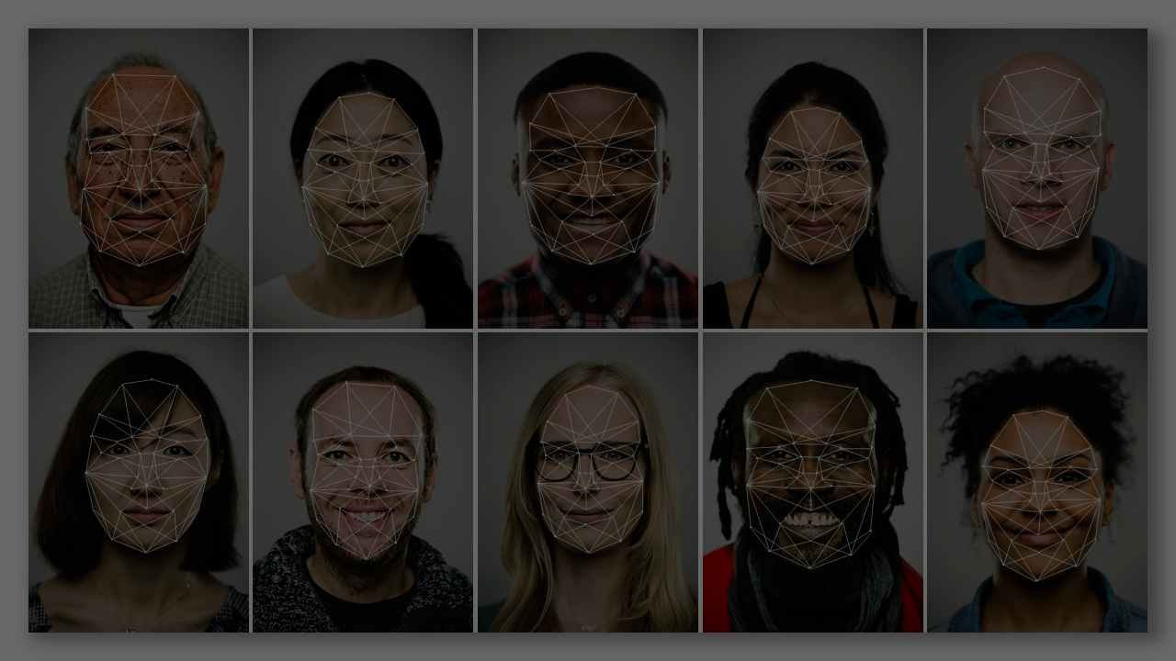
Practical Applications
Images
Facial Recognition
Machine Vision (Self-driving cars)
Searching by Image

Slide 11
practical applications
Natural Language Processing (NLP) – analyzing and representing human language (e.g. sentiment analysis, machine translation, dialogue generation)
Fraud/threat detection
Recommendation engine (targeted ads!)

Slide 12
Opensource Deep learning frameworks

Slide 13
Why use matlab?
You already know how to code in MATLAB.
You can easily integrate with other MATLAB tools.
You can get personalized technical support from MathWorks.
You can still import pretrained networks from other frameworks.

Slide 14
Today’s workshop
Use a pretrained network to classify images
Modify a pretrained network to classify images into new specified classes
Build a convolutional neural network from scratch

Slide 15
MATLAB ONLINE
Go to https://workshops.rc.virginia.edu/lesson/matlab-deep-learning
Download the sample image dataset
Log into MATLAB Online: https://matlab.mathworks.com/
(You may need to create an account)
Upload the sample image dataset to your MATLAB Online workspace

Slide 16
More resources
MATLAB Academy: https://matlabacademy.mathworks.com/
Courses on Deep Learning, Machine Learning, etc
Email us: hpc-support@virginia.edu
Office Hours:
Tue/Thu 3-5pm at PLSB 430
Thu 10am-12pm Health Sciences Library Mill Room (1st floor helpdesk)

